Slide 1


About Safe Towers
SAFE TOWERS PVT LTD
Specialize in Designing and Manufacturing of Communication, Media & Electrical Structures and Affiliated
Services. The company was formed in 2010 and is located at Muradnagar & Morta (Ghaziabad, Uttar Pradesh)
with 250+ employees
Customer Base
PAN India
Global: Seychelles ■ Bangladesh ■ Bhutan ■ Brazil ■ Kuwait ■ Myanmar ■ Nepal ■ Oman ■ Qatar ■ Saudi ■ UAE
PRODUCT RANGE:
Communication Structures:
■ Radar Navigation
■ Monopole-Roof Top and Ground Based
■ Smart Poles ■ Fast Track Towers■ Hybrid Towers
Outdoor Structure & Solar:
■ Media Bill Boards ■ Street Light Poles
■ Solar Photovoltaic Structures
Sales
Turnover in INR Cr
Turnover in INR Cr

Slide 2
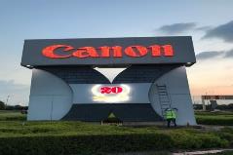
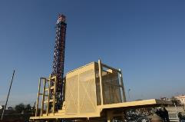
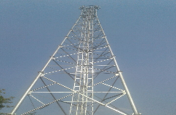
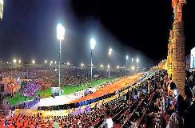
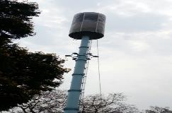
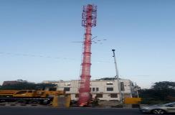
Product Portfolio
FAST TRACK TOWER
HYBRID TOWER
MEDIA DISPLAY BILL BOARD
CAMOUFLAGE MONOPOLE
MONOPOLE TOWER
HIGH MAST TOWER

Slide 3

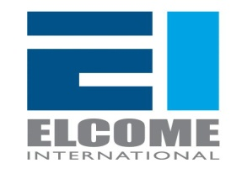

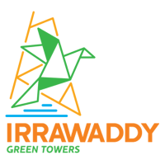

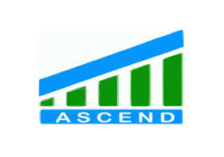
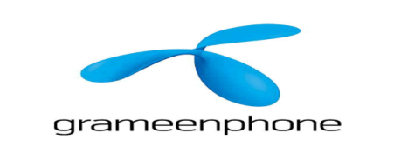










Our Major Customers
GLOBAL
DOMESTIC

Slide 4
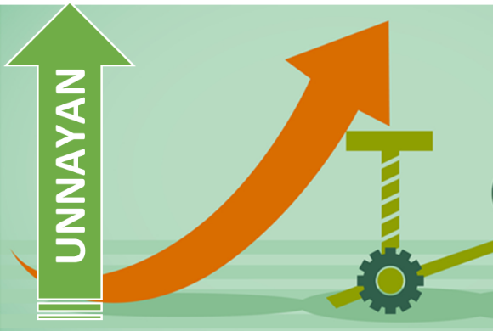
उन्नयन - The Transformation Journey
उन्नयन is the Partner Upgradation Program launched by INDUS TOWERS
Team comprising of senior Quality Management Systems and Process Experts for supporting partners in:
Holistic Gap Assessment
Help Partners in defining Appropriate Solutions and Best in Class Practices
Handholding Partners in Implementing Actions

